Slide 1

The Battle of the Neighborhoods

Slide 2
Introduction
Customer: Rasa is a well-known restaurant brand from Malaysia and has recently expanded its business to Toronto, Canada.
Business Problem: Due to the huge success of its first international branch in Toronto, the owners of Rasa have decided to expand their business in New York, a city known for its diverse population.
Objective: The next step for the owners now is to identify a suitable location in one of New York City’s neighbourhood to open up the restaurant.
Target Audience: Besides being useful to the owners, this project can also assist other business owners looking to expand their businesses anywhere around New York city.

Slide 3
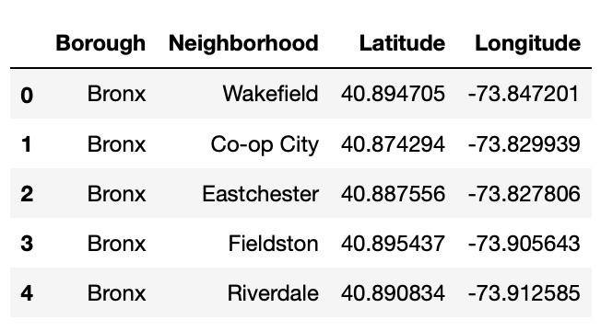
DATA
New York location data: https://geo.nyu.edu/catalog/nyu_2451_34572.
Contains 5 boroughs and 306 neighbourhoods
Using this dataset, we extract features that will be used in the analysis, which are Borough, Neighbourhood, Latitude, and Longitude.

Slide 4
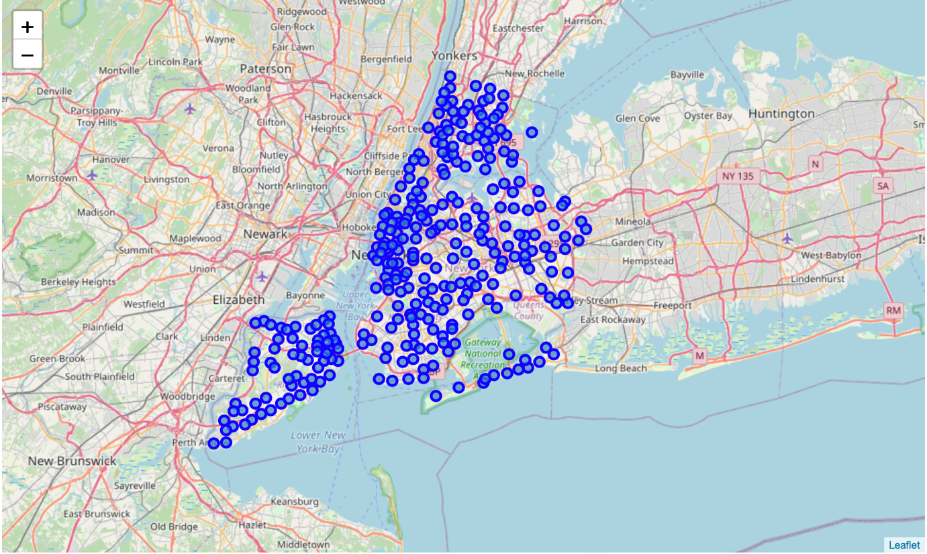
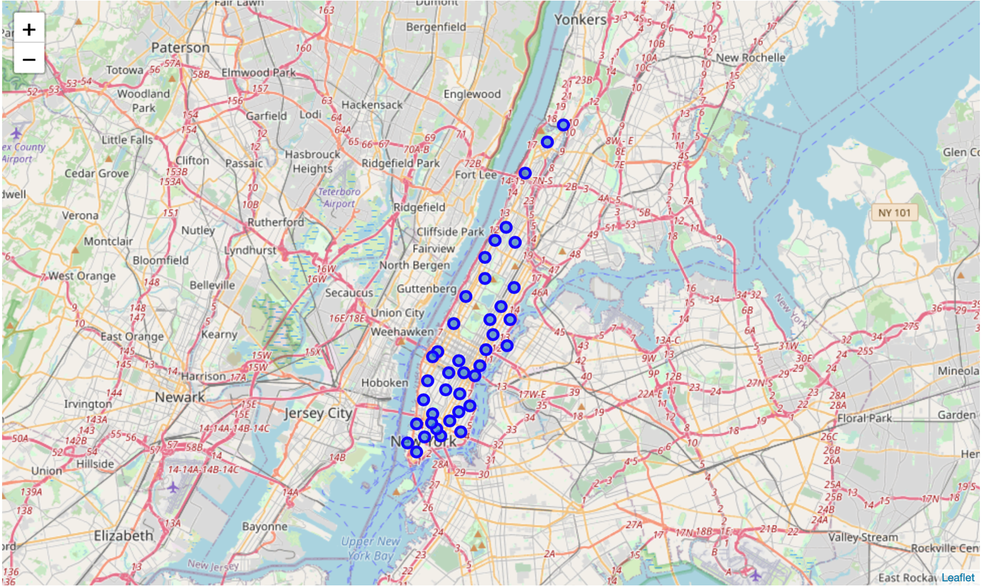
DATA
However, notice how there are too many neighbourhoods to analyse.
To overcome this problem, we focus on only one borough instead, which is Manhattan, since that is where most of New York City’s main attractions (Broadway, Central Park, and Empire State Building) are located at.
By doing this, we managed to narrow down the initial dataset into 40 neighbourhoods .

Slide 5
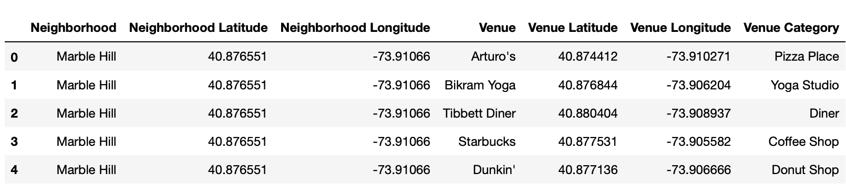
DATA
Once we are satisfied with our final dataframe, we proceed to explore venues available in each neighbourhood.
To do this, we extract information from Foursquare and identify the top 100 most common venues within a radius of 500 meters in each neighbourhood.

Slide 6
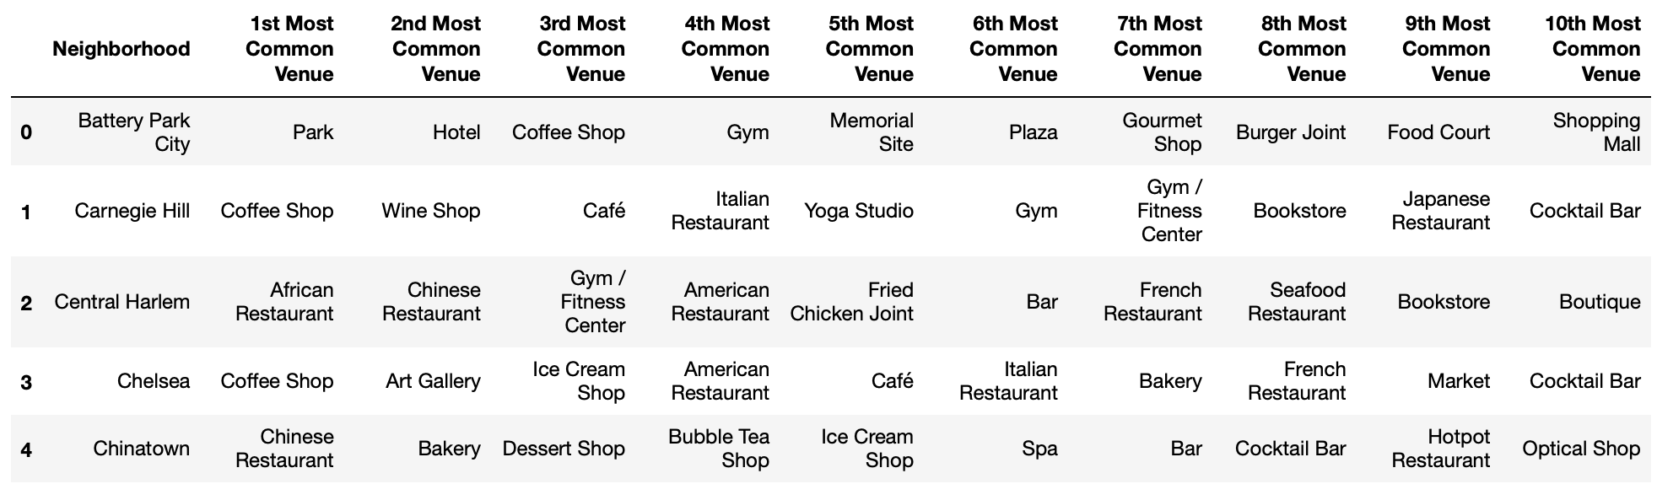
Methodology
Since the name of venues are of no value to us, we decide to look at the venue category instead.
However, looking at the venue categories individually in each neighbourhood will not provide any sort of analysis to us.
Hence, we take the mean of the frequency of occurrence of each category and group rows by neighbourhood.
However, there are a total of 328 unique venue categories to look at. To further assist our analysis, we narrow it down to only the 10 most common venue categories in each neighbourhood.

Slide 7
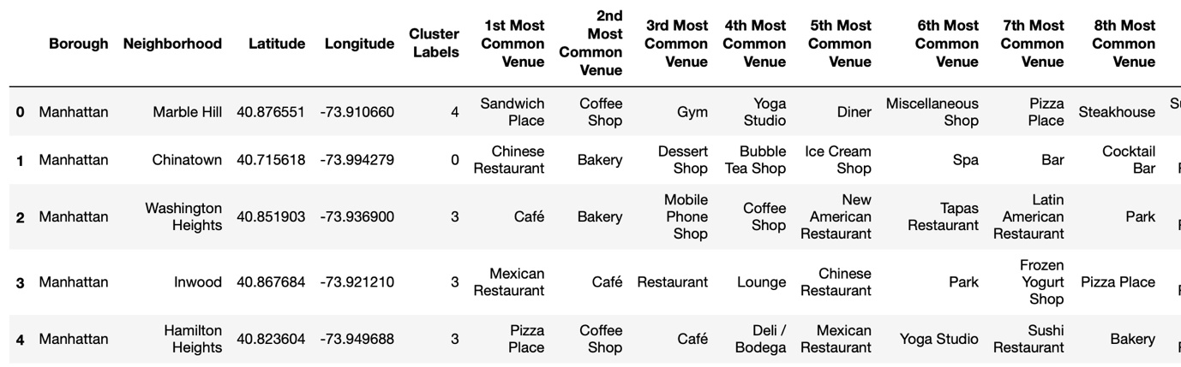
METHODOLOGY
Now that we have obtained the top 10 most common venue in each neighbourhood, we will use K-Means clustering to group the neighbourhoods into 5 different clusters.
We append the cluster labels, latitude, and longitude for each neighbourhood.

Slide 8
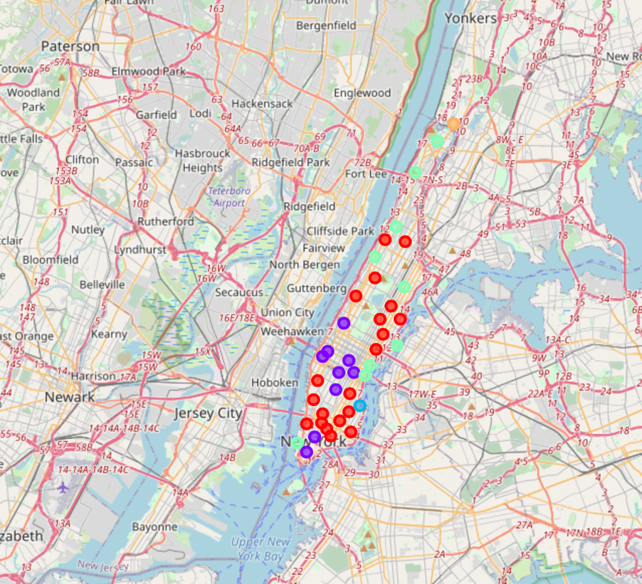
results
Cluster 1 (Red):
20 Neighbourhoods
Cluster 2 (Purple):
9 Neighbourhoods
Cluster 3 (Blue):
1 Neighbourhood
Cluster 4 (Teal):
9 Neighbourhoods
Cluster 5 (Orange)
1 Neighbourhood

Slide 9
Discussion
Looking at both Cluster 1 and Cluster 2, there are a lot of ethnic restaurants in the area which may imply the presence of a diverse population.
However, Cluster 1 would be a second option compared to Cluster 2. This is because in Cluster 1, we can see there are also more Asian restaurants in the area compared to Cluster 2.
Choosing Cluster 2 may reduce the risk of competition among other Asian restaurants, since Rasa’s main dishes are targeted towards those who prefer Asian cuisines (Malay, Chinese, and Indian).

Slide 10
conclusion
Using K-Means clustering on location data for New York and Foursquare API, we were able to narrow down 40 different neighbourhoods into 5 different clusters.
Based on the analysis done in this study, we have decided that the best place for Rasa to expand their business is in Cluster 2.
While Cluster 1 is could also be a potential location, Cluster 2 reduces competition risk.
However, once Rasa has established itself in New York City with its upcoming branch, it could be a good idea for Rasa to expand in Cluster 1 as well.

